Slide 1
Stack
Mr. Yogesh Sharma
Assistant professor
Cse, mait

Slide 2
Definition and Overview of Stacks
What is a stack?
Stores a set of elements in a particular order
Stack principle: LAST IN FIRST OUT = LIFO
It means: the last element inserted is the first one to be removed

Slide 3
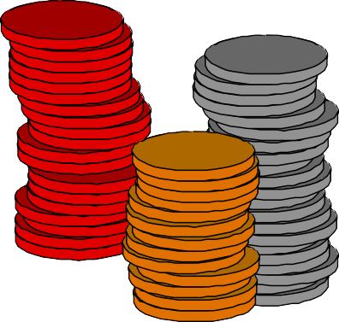
Example
Which is the first element to pick up?

Slide 4
Last In First Out
A
B A
C B A
D C B A
E D C B A
D C B A
top
top
top
top
top
top

Slide 5
Static and Dynamic Stacks
Static Stacks
a) Fixed size
b) Can be implemented with an array
Dynamic Stacks
a) Grow in size as needed
b) Can be implemented with a linked list

Slide 6
Stack Operations
Push
causes a value to be stored in (pushed onto) the stack
Pop
retrieves and removes a value from the stack

Slide 7
Working of Stack Data Structure
The operations work as follows:
A pointer called TOP is used to keep track of the top element in the stack.
When initializing the stack, we set its value to -1 so that we can check if the stack is empty by comparing TOP == -1.
On pushing an element, we increase the value of TOP and place the new element in the position pointed to by TOP.
On popping an element, we return the element pointed to by TOP and reduce its value.
Before pushing, we check if the stack is already full
Before popping, we check if the stack is already empty

Slide 8
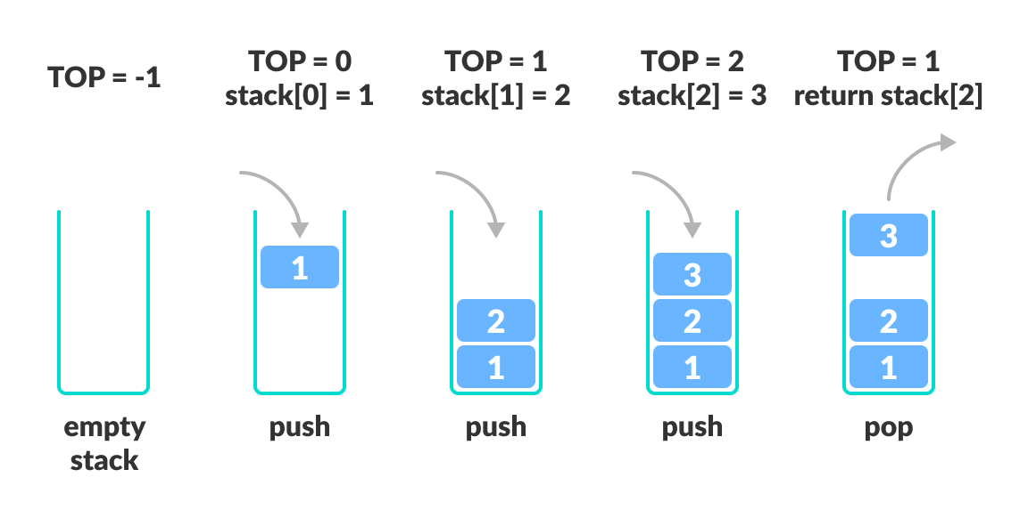

Slide 9
Stack Push Algorithm PUSH_STACK(STACK,TOP,MAX,ITEM)
Algorithm to push an item into stack.
1) IF TOP = MAX then
Print “Stack is full”;
Exit;
2) Otherwise
Read ITEM
TOP: = TOP + 1; /*increment TOP*/
STACK (TOP):= ITEM;
3) End of IF
4) Exit

Slide 10
Stack Pop algorithm POP_STACK(STACK,TOP,ITEM)
Algorithm to pop an element from stack.
1) IF TOP = -1 then
Print “Stack is empty”;
Exit;
2) Repeat step 3 to 5 until Top>0
3) ITEM: =STACK (TOP);
4) TOP:=TOP – 1;
5) Write Deleted ITEM
4) Exit

Slide 11
Numerical
Consider the sequence of integer : 10,3,7,12,31,45,23,12 to be pushed into the stack of size 8. what will be the 4th and 6th element of the stack if after every three push operation one pop operation is performed.

